Slide 1
Negotiation Skills

Slide 2
https://www.youtube.com/watch?v=0CdixDzE7I0
Objectives
The aim of this exercise is that the audience
is more sensitised for “negotiation” and its related skills
knows some of the characteristics of situations where negotiation skills are needed
can identify Do´s and Don´ts that apply to such situations
can systemize some of the own experiences related to “negotiation skills”
Page 2

Slide 3
Which picture do we have in mind, when we are talking about negotiations?

Slide 4
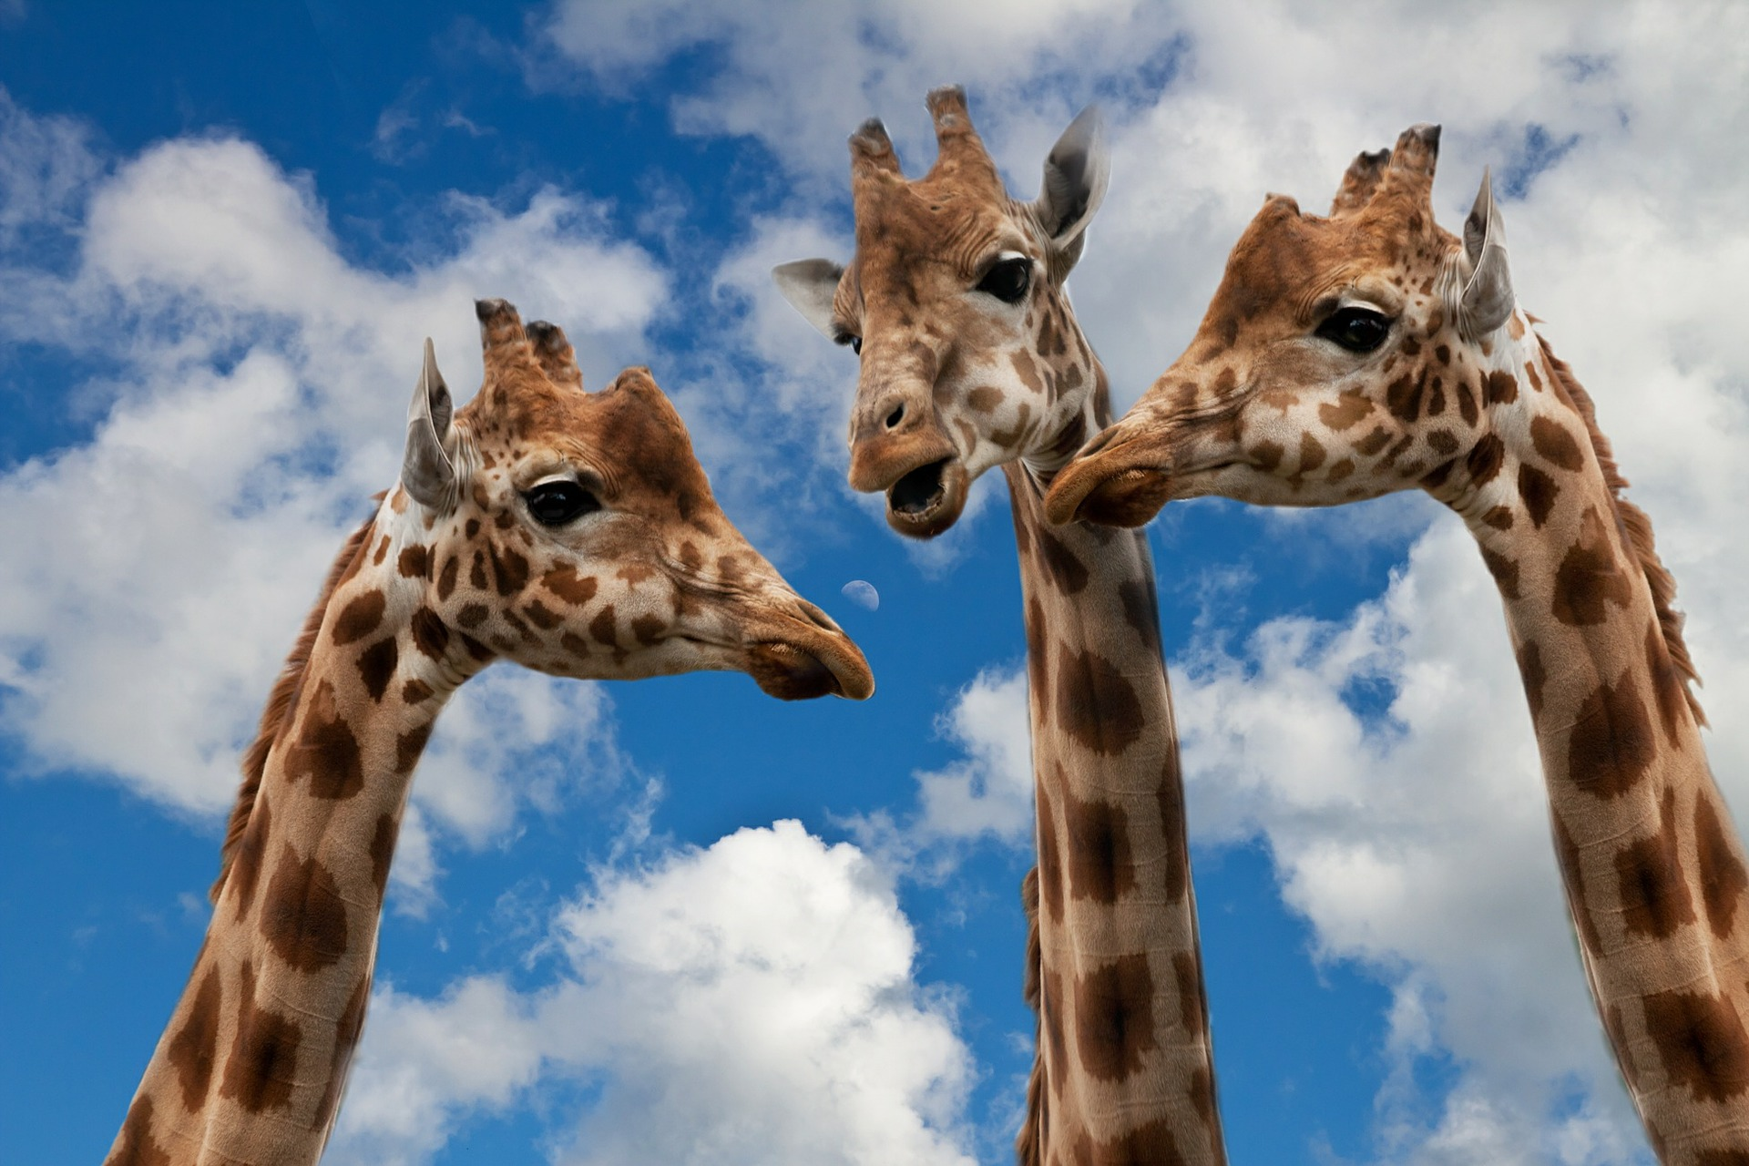
Which association do you have when you see this picture?
Page 4

Slide 5
Which association do you have when you see this picture?
Page 5

Slide 6
Which association do you have when you see this picture?
Page 6

Slide 7
https://www.youtube.com/watch?v=0CdixDzE7I0
Exercise “Thirteen Days”
Step 1: Please devide in four groups:
Please count 1,2,3,4,1,2…
Step 2: Watch the video:
Each group will be given a specific task
Step 3: 10 minutes for preparation of answers
Please write all your ideas on post-its
Please nominate a representative of your group
Step 4: 2 minutes presentation of each group
Please use the pin boards
Please try to cluster your results
Ready to start the video? https://www.youtube.com/watch?v=3cThXPi2fMc (go to 4’17”)
One more time?
Page 7

Slide 8
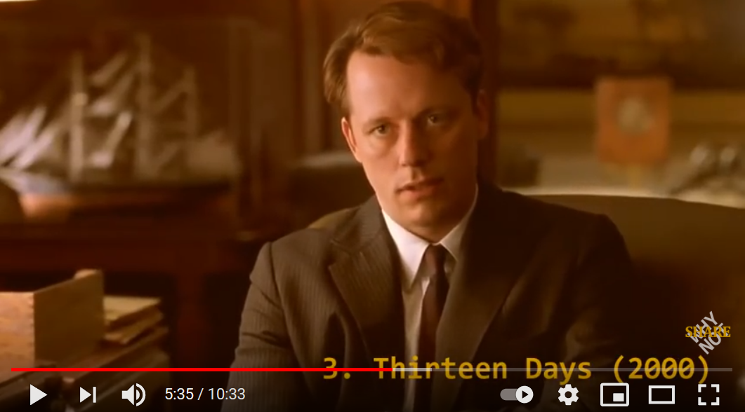
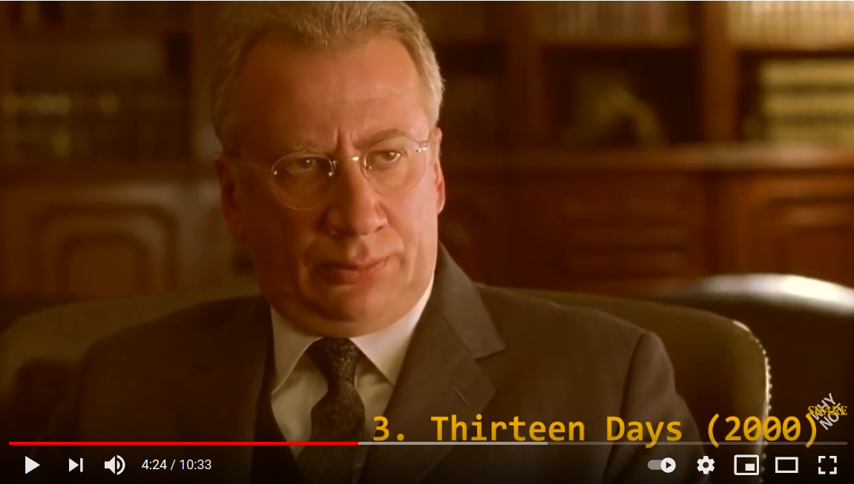
https://www.youtube.com/watch?v=0CdixDzE7I0
Exercise “Thirteen Days”
1st Group: US American diplomat!
What could science diplomats learn from him? (in terms of strategy, goal-orientation, personal negotiating style?)
What should science diplomats avoid?
2nd Group: Russian diplomat!
What could science diplomats learn from him? (in terms of strategy, goal-orientation, personal negotiating style?)
What should science diplomats avoid?
3rd Group: Please collect missing skills (both diplomats)!
Which skills relevant for science diplomats are completely missing?
4th group: Please identify the most relevant skills (both diplomats)!
Which skills are relevant for science diplomats?
Page 8

Slide 9
www.s4d4c.eu
@s4d4c
Maria Josten | WP5 Training Activities | maria.josten@dlr.de
Page

