Slide 1
Negotiation Skills

Slide 2
https://www.youtube.com/watch?v=0CdixDzE7I0
Objectives
The aim of this exercise is that the audience
is better prepared for negotiation
knows how to apply some important negotiation skills, for example,
differentiates and identifies interests and goals
is clear in the determination of goals, areas for discussion and alternatives to the stated goals
listens actively
keeps an emotional balance and a good relationship
describes targets and preferred measures clearly
maintains good ethics and reliability
becomes more flexible and tolerant
knows some of the relevant key concepts

Slide 3
Negotiations in the field „Science Diplomacy“:
How to reach a win-win solution?

Slide 4
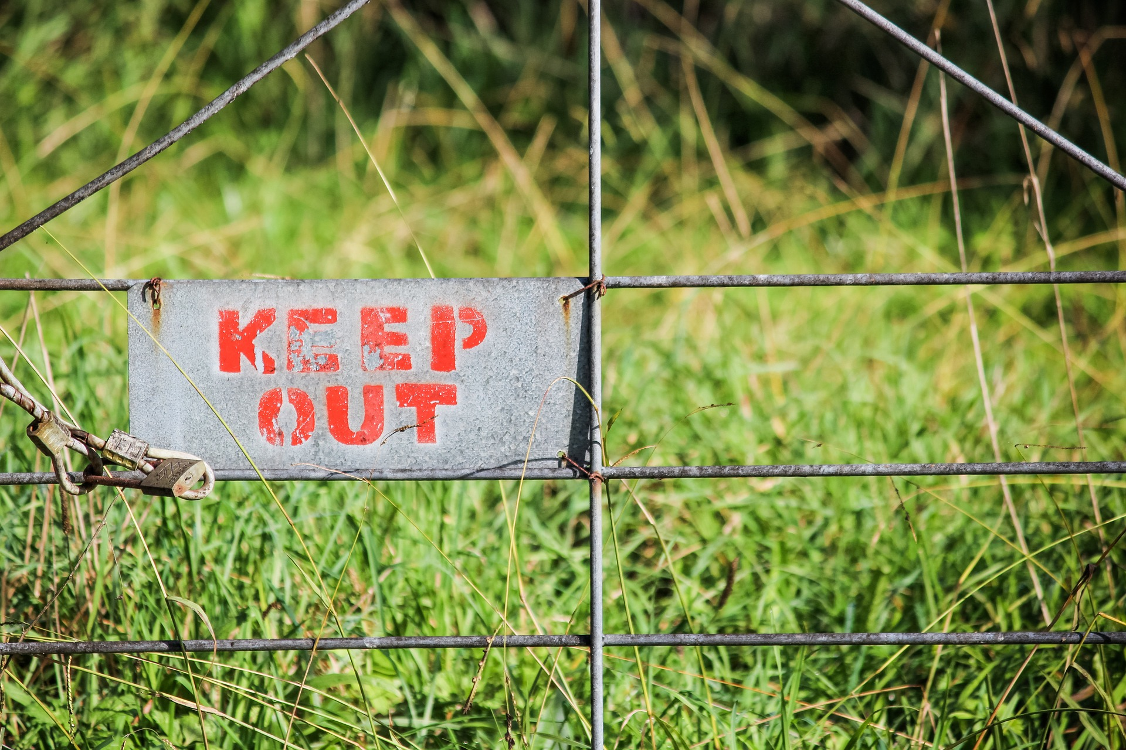
General rules

Slide 5
General rules for preparing negotiations
Problem analysis to identify interests and goals
You have to determine the interests of each party in the negotiation: scientists, diplomats, policy makers etc. Please note: The interests (the question why I do something) may be different from the goals that I want to reach in the very situation (what do I want to reach right now)
Example for a S&T agreement negotiation: My general interest is to strengthen my own power position (e.g. more and easier access to funds), but right now, I try to negotiate which of my short- term strategies will fit best into the current joint initiatives
For here and the forthcoming slides, cf. this source: https://smallbusiness.chron.com/top-ten-effective-negotiation-skills-31534.html

Slide 6
General rules for preparing negotiations
Determine your goals, areas for discussion and alternatives to the stated goals
You should study the history of the relationship between the two parties and past negotiations to find areas of agreement and common goals.
S&T agreement negotiation: It is easier to find a solution when you can build on a common ground; therefore, check the history of your relationship: Which scientific topics were important for our cooperation in the last years? Which goals can we both easily agree to? Which topics have changed?

Slide 7
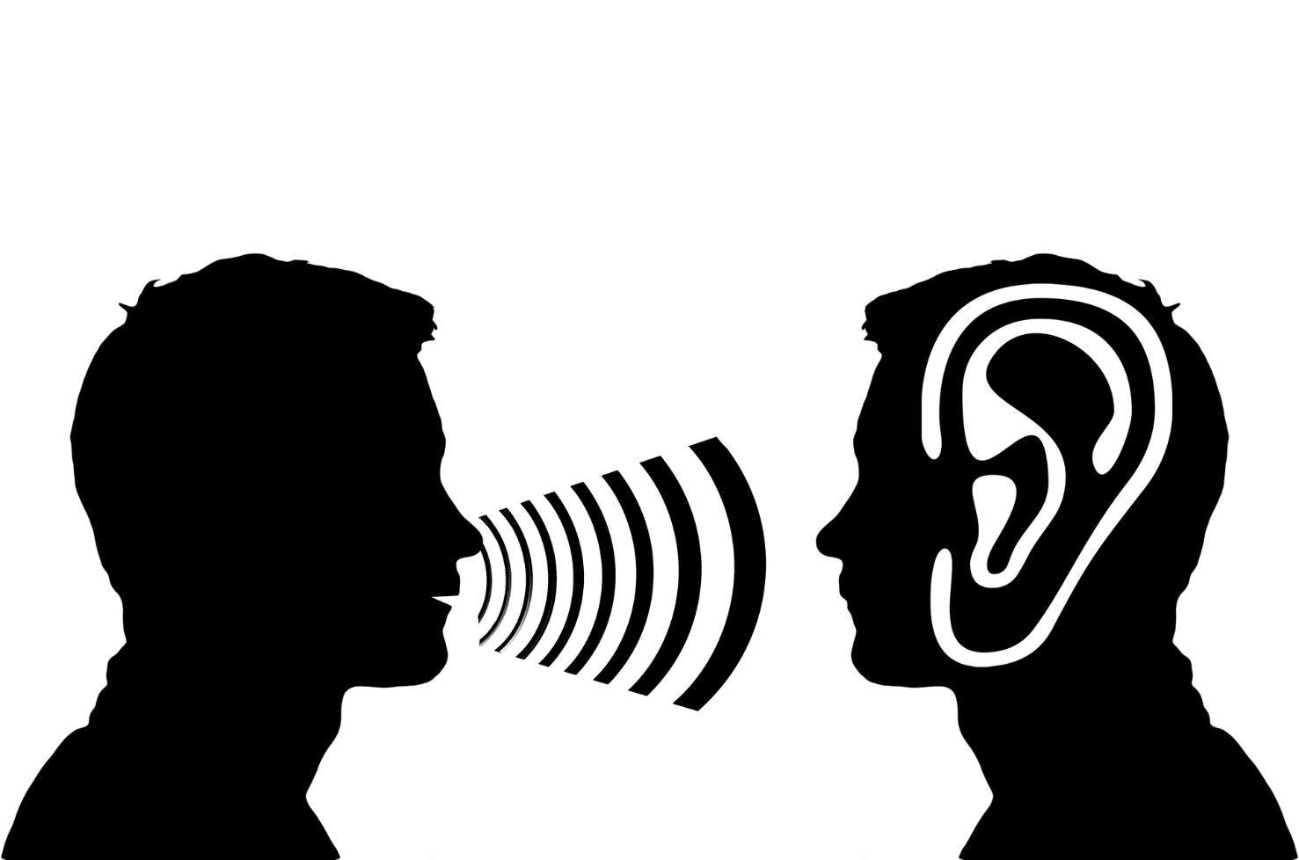
General rules for preparing negotiations
Listen actively to the other party or other parties during the debate Active listening involves the ability to read body language as well as verbal communication, but not only: show your partner that you are an active listener by sending positive signals, e.g. nodding and physical symmetry (adopting the same posture), or as well negative ones, e.g. physical distancing (turning the head away), etc.
S&T agreement negotiation: signs of body language can be a symptom for a certain reservation with a topic or uncomfortness with the situation, but as well for a dominance-claiming opinion and an assertive position
Train to listen to yourself actively, too: It’s not what you say but how you say it

Slide 8
General rules for preparing negotiations
Keep emotions on a string
While a negotiation on contentious issues can be frustrating, allowing emotions to take control during the negotiations can lead to unfavorable results. Remember: Every conversation consists of task-related and relationship-oriented components. In case of doubt, don’t get personal, just stick to the point.
S&T agreement negotiation: Scientists are convinced of their results and the necessity of a quick implementation of activities. Policy makers might be confident with the outcome of the research, but they have to maintain good relationships with many stakeholders.

Slide 9
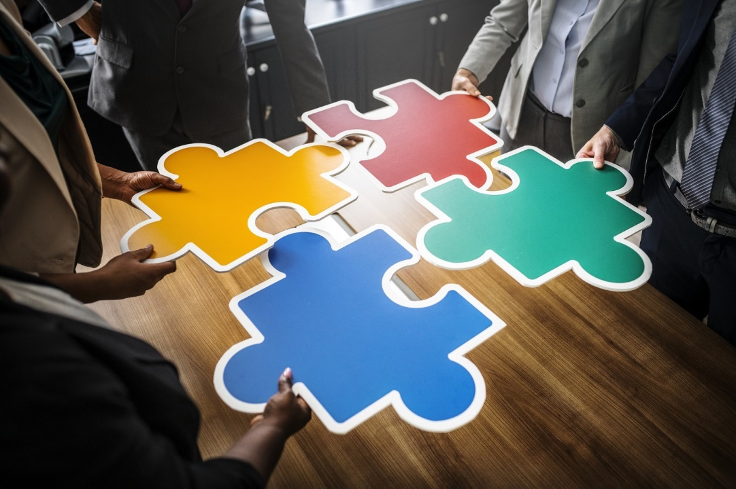
General rules for preparing negotiations
Communicate clearly and effectively to the other side during the negotiation
You should prepare your statement carefully in advance, e.g. by answering yourself a bundle of questions. Explain everything in a comprehensive but still simple way. If possible use “storytelling”. In an encounter with people from a different culture, try to put a little bit more effort in elaborating on your theme and issues. Ask your partners whether everything became clear.
S&T agreement negotiation: What do we want? Why do we want it? Who was involved? When and where is it supposed to happen? How did we do it last time? What do we offer for better achievement this time?

Slide 10
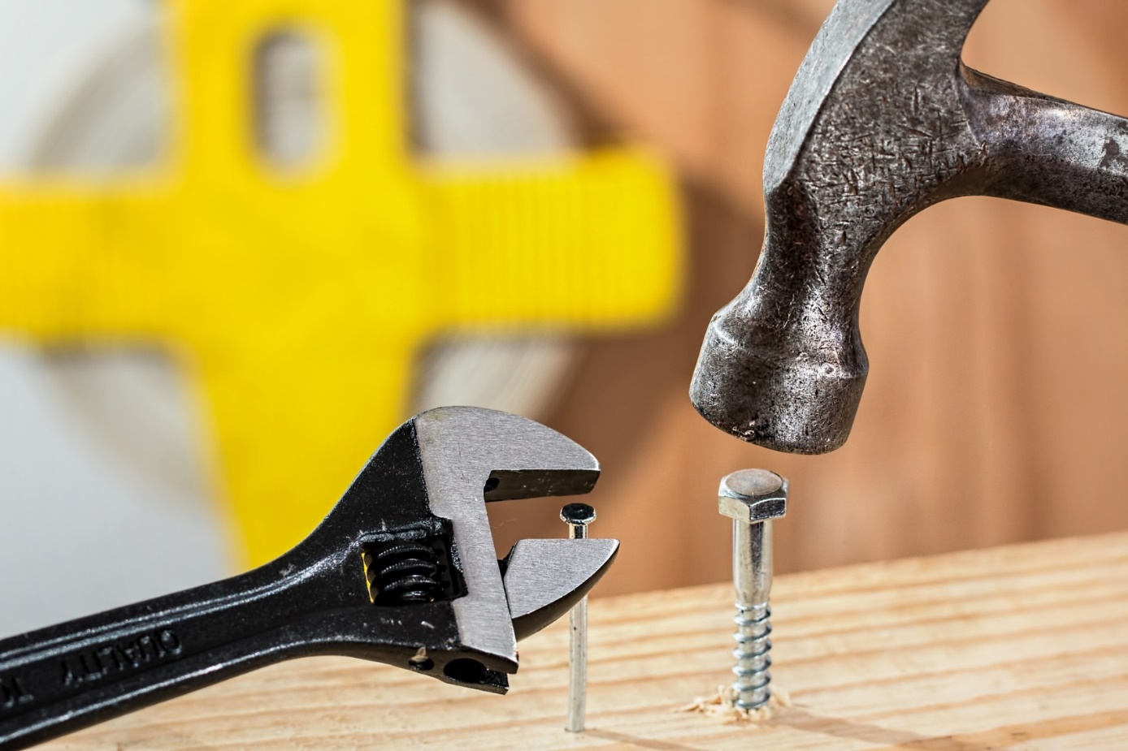
General rules for preparing negotiations
Seek a variety of solutions to problems and take decisions
You should be flexible and creative. Act decisively during a negotiation. It may be necessary during a bargaining arrangement to agree to a compromise quickly. Be prepared for alternatives and a certain range for expected and unexpected moves of the other party.
S&T agreement negotiation: New topics can be brought on the table quickly, others can be forgotten just as fast – make sure that nothing of importance is deleted, even if you are caught cold, and that you can always keep open a possibility to act

Slide 11
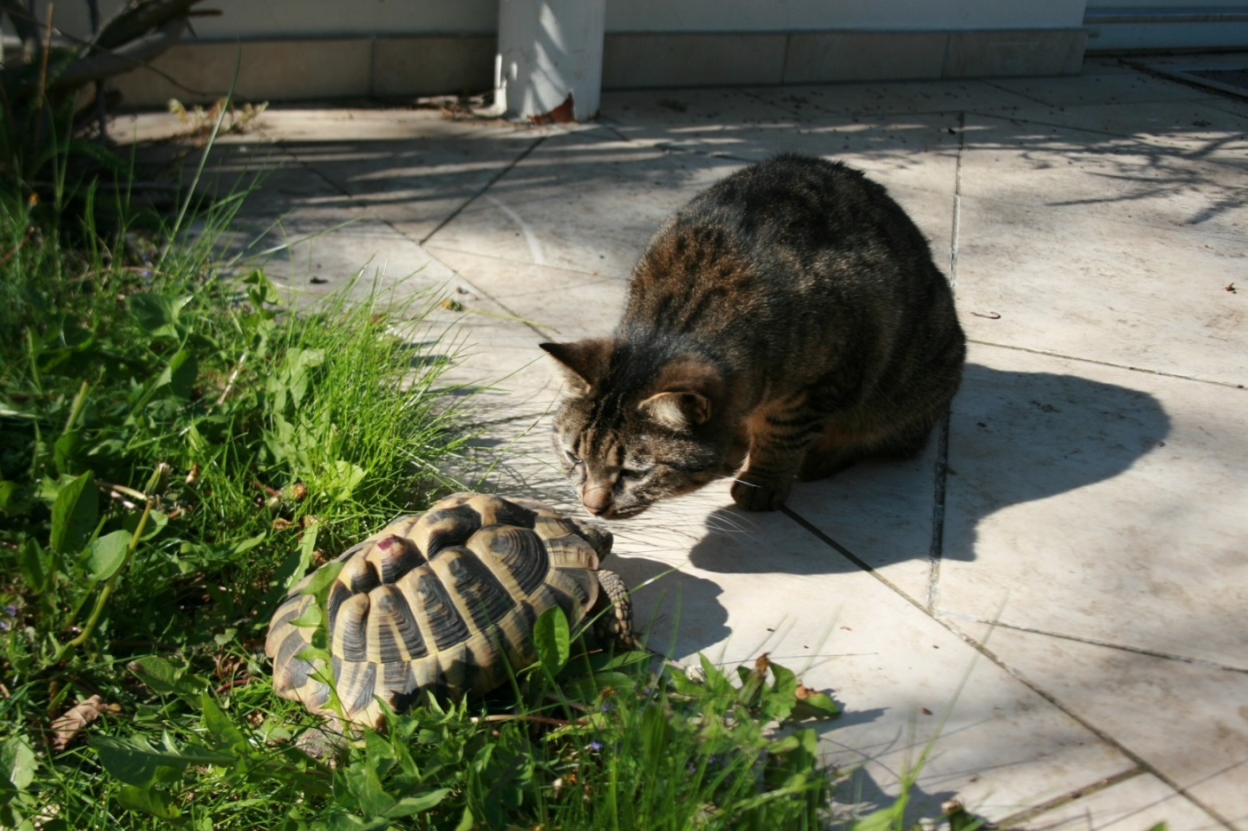
General rules for preparing negotiations
Maintain good relationships
Be patient and do not manipulate others. Try to maintain a positive atmosphere during a difficult negotiation.
S&T agreement negotiation: We have used the coffee breaks for small talk, we have had a longstanding cooperation and we know each other very well. Have in mind: You always meet twice, and your partner may first remember your friendliness, your hospitality and your smile.

Slide 12
General rules for preparing negotiations
Ethics and reliability
Both sides in a negotiation must trust that the other party will follow through on promises and agreements. You must have the necessary skills and competences to execute and perform after bargaining ends.

Slide 13
The Conceptualisation of Methods
The following concepts will serve as examples for the theoretical work that has been realised on negotiation. It’s a selection and not meant to be representative for the whole academic work on the topic. We will concentrate on the following:
The Harvard Negotiation Method
BATNA
The differentiation of distributive vs integrative negotiation
Further reading:
Stokes, L.C., Selin, N.E. The mercury game: evaluating a negotiation simulation that teaches students about science-policy interactions. J Environ Stud Sci 6, 597–605 (2016). https://doi.org/10.1007/s13412-014-0183-y

Slide 14
The Harvard Negotiation Method
This negotiation method was first introduced by Fisher and Ury in 1981 in a publication called “Getting to Yes”
Since then it is successfully used for negotiations and it is part of the curriculum at Harvard Law School
The Harvard Negotiation Method is based on communication and fair treatment
Using this method, you do always try to reach a win-win situation
The method guarantees a high acceptance of the negotiation results on both sides
It consists of four basic principles

Slide 15
The Harvard Negotiation Method
Discuss the subject matter: Concentrate on the facts and the task and leave personal aspects aside – but without running the risk of doing harm to the relationship
Focus on the interests: Try to identify the interests of each party and do not only consider the positions they formulate in the ongoing negotiation; the interests are the basic motivation, and they are sometimes hidden (visualizing the interests in a list may help)
Develop alternatives: Do not try to find the “perfect” solution, because it usually does not exist, and try to avoid an “either-or" perception of things either; this will allow you to discover new options and develop alternative solutions (a mind map might be helpful)
Objective decision criteria: Once you have developed potential solutions with your negotiation partner, the actual decision-making process begins; try to stick to objective decision criteria and evaluate all possible results accordingly; based on this evaluation you should be able to make a decision which unites all interests
Source: https://www.inloox.com/company/blog/articles/getting-to-yes-how-to-negotiate-using-the-harvard-principle/

Slide 16
BATNA
BATNA ("Best Alternative To a Negotiated Agreement") is one of the key concepts that are used for describing and conceptualizing negotiation processes. If an agreement is not reached in a negotiation BATNA stands for the best alternative option that can be reached.
BATNA is a flexible point of reference that can be set by the negotiator as a threshold beyond the minimum and maximum margins of a negotiation. Thus, BATNA is part of the preparation for a negotiation and does not need to be communicated to the other party.
BATNA can be understood like a fallback option that allows the negotiator to avoid a situation in which you are running the risk of a negotiated conclusion which has a lower value than your BATNA.

Slide 17
The differentiation of distributive vs integrative negotiation
The term “distributive” negotiation means that a negotiating partner concentrates on the fulfilment of his or her personal interests. No consideration is given to the loss that the other may have. “Integrative” negotiation, however, takes into account the common interests of all parties involved. This makes constructive solutions possible, which in the best case mean an advantage for all.
Distributive negotiation is sometimes denominated a “fixed-pie-strategy”, which means that each party obtains a definite portion of the “cake”. This negotiation strategy is useful of even mandatory when there a fix costs but only limited resources.
Integrative negotiation leads to a win-win-situation. It might be necessary to analyse the needs and wishes of the other party carefully to be able to show the advantages of your arguments. Still, each has to give up something.

Slide 18
Exercise: „Self-reflexion“
Option 1: “Letter to myself”
Please take a card and write down the answer to the following question:
How can you make your negotiation a successful one?
Option 2: “My picture”
Please choose the picture you like most and answer the following question:
Which negotiation rule seems most important to me?
Please keep in mind your answer!
Do not forget your “letter” or “picture” during the preparation of the simulation game!

Slide 19
www.s4d4c.eu
@s4d4c
Maria Josten | WP5 Training Activities | maria.josten@dlr.de

